Slide 2
CS 4530: Fundamentals of Software Engineering Module 3, Lesson 2 Architecting Simple Web Servers
Rob Simmons
Khoury College of Computer Sciences

Slide 3
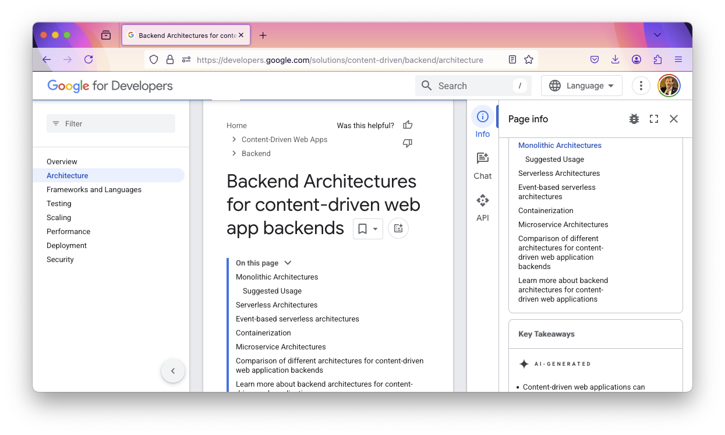
???

Slide 4
Learning Goals for this Lesson
At the end of this lesson, you should be able to
Explain what “business logic” is
Describe the fundamental differences between the three layers of the controller, service, and repository layers in a C-S-R architecture
Explain the difference between “horizontal” and “vertical” scaling
Know what someone is talking about when they say “microservices”

Slide 5
This example is silly
numLogins resets whenever you stop running the program
import express from 'express’;
import { z } from 'zod’;
type UserAuth = z.infer<typeof zUserAuth>;
const zUserAuth = z.object({
username: z.string(),
password: z.string(),
}); let numLogins = 0; const app = express();
app.use(express.json());
app.post('/api/user/login', (request, response) => {
const { username, password }: UserAuth = zUserAuth.parse(request.body);
if (username.toLowerCase() === 'user1' && password === 'sekret') {
response.send({ success: true, numLogins: numLogins++});
} else {
response.send({ error: 'Invalid username or password' });
}
});
there’s one user and one password and it’s hard-coded

Slide 6
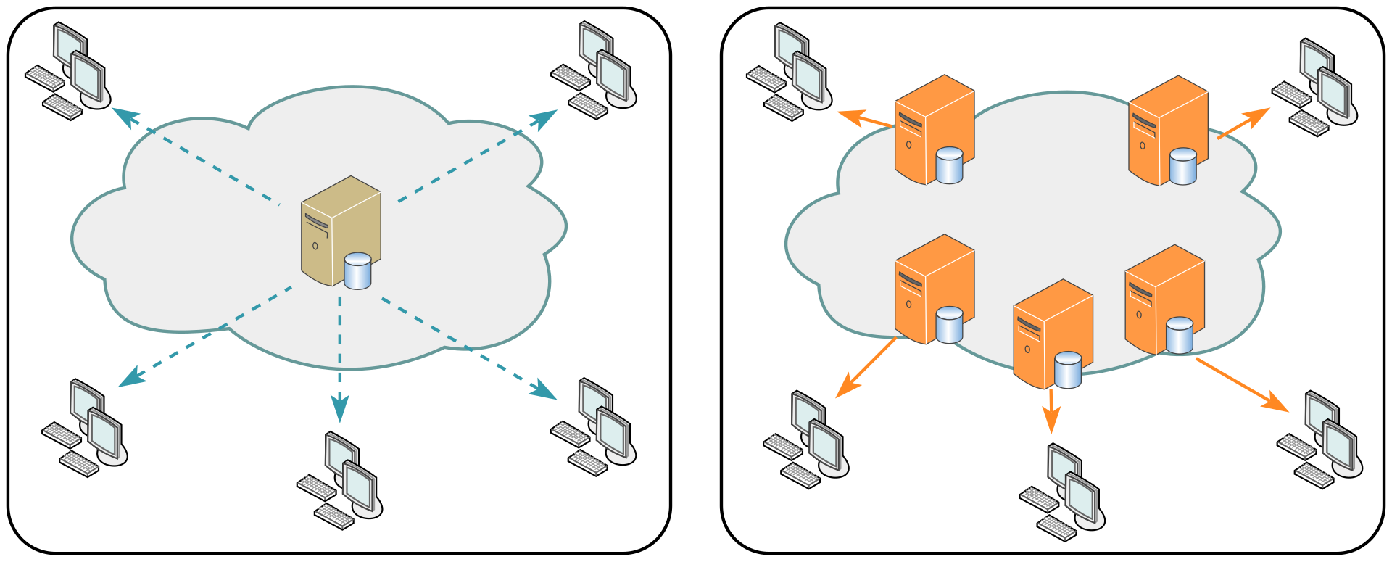
State and statelessness
Web applications have state: they’re ultimately storing or modifying something
Otherwise, maybe don’t have a server running Node at all?
Content Delivery Networks have put tons of work into solving that distributed systems problem.
Static sites are fast & cheap
https://en.wikipedia.org/wiki/Content_delivery_network
Notes:
What are exceptions to the fact that web applications have state?

Slide 7
State and statelessness
A web server or web service should be stateless
Every REST request should be indifferent to whether the node application has been running for several hours or five seconds
Our silly application, and the IP1 code, is not stateless (why?)
If the web server is going to be stateless, and the web application has state, the server has to phone a friend:
Access the filesystem
Query a database
Initiate some other remote procedure call to another server
Common case: a database is the point of centralization
Centralization (& hierarchical centralization) is a cheat code for making distributed systems managable

Slide 8
Three parts of a web server
The repository is the only part that stores state
I think it would be clearer if we called it the “database” tbh
The service doesn’t know how we connect to the client
HTTP? REST? WebSockets? The service shouldn’t know!
The controller doesn’t know how we store data
Are we actually stateless, or storing things in memory?
MongoDB? PostgresQL? SQLite? A file on the hard drive?
Repository
API
Service
API
Controller
internet
Client
browser
User

Slide 9
Service interface
import {
StudentID,
Student,
Course,
CourseGrade,
Transcript,
} from './types.ts';
export interface StudentService {
addStudent(studentName: string): Student;
getTranscript(id: Student): Transcript;
deleteStudent(id: Student): void;
addGrade(id: Student, course: string, courseGrade: CourseGrade): void;
getGrade(id: Student, course: string): CourseGrade;
populateNames (studentName: string): Student[];
}

Slide 10
Service interface
Everything we saw from the transcript server is the business logic — the most boring name possible for “the interesting stuff that a web server does that isn’t just reading from a database”
“Is this person an authenticated user?” — usually not business logic
“Does this user have permission to access student records” — business logic!
“Do new grades go at the front or back of the list” — business logic!

Slide 11
Testing
We can test at both the service layer and the controller layer
What are the pros and cons of each?
Sometimes we’ll want to test the service layer and/or controller layer without the repository layer!
We’ll come back to this.

Slide 12
Web Applications are Distributed Systems
Distributed systems are hard!
Web applications are designed to only be kinda difficult-to-build distributed systems
Most of this lecture is bad advice if you’re Google, Netflix, or Amazon
Web applications are distributed systems because
You don’t live in the cloud
Scalability: Netflix needs at least two computers

Slide 13
Scaling & the database bottleneck
Web services often start on a single computer
Stateless web servers make it possible to horizontally scale your web service as you get more users: add more cheap stateless web servers!
AWS will be delighted to help, only real limit is money
Centralized databases tend towards vertical scaling: move your database to a more powerful computer
This has limits

Slide 14
Scaling & the database bottleneck
Most applications want to do expensive but periodic data analysis on the database
Database read-only-replicas are an easy solution here — seconds to minutes behind reality (and can add reliability in case of failure!)

Slide 15
Scaling & the database bottleneck
If you’ve got a bunch of data (or computation) that can handled separately and independently, you can put that somewhere else and have two independent databases
Chat and game information could be in separate places
Games could have their business logic running on different servers, written in different programming languages, and accessed (by the server the client is connected to) through their own REST API!
This way lies microservices

Slide 16
Microservices
Different languages, different operating systems
NodeJS, MongoDB
Google Service
Java, MySQL
Todos
Logins
Mailer
Mod 1
Mod 2
Mod 3
REST service
REST service
REST service
Productivity App
Database
Database
Database
Frontend
REST
Search Engine
Analytics
Social Crawler
“Dumb”
App Server
Mod 4
Mod 5
Mod 6
REST service
REST service
REST service
Database
Database
Database
Java, Neo4J
C#, SQLServer
Python, MongoDB
Notes:
Here is an example of a micro services architecture for a productivity application. There are multiple components to this application. Each component is shown as a grey box, and is a micro service.
(Note the separation of responsibilities to entirely different services that only connect over a well-defined API)

Slide 17
Microservices
Netflix is the microservices darling
100s of microservices
1000s of daily production changes
10,000s of instances
BUT:
only 10s of operations engineers
https://medium.com/refraction-tech-everything/how-netflix-works-the-hugely-simplified-complex-stuff-that-happens-every-time-you-hit-play-3a40c9be254b

Slide 18
Microservices
The opposite of “microservices” is “monolith”
higher is better
https://martinfowler.com/microservices/
Notes:
Microservice advocates claim that as the system grows in complexity, the micro service abstraction provides gains in understanding and productivity that outweigh the cost of the added complexity.
It would be interesting to have some hard data about this, but companies probably don’t want to be too transparent about stuff like this.

Slide 19
Review
Strategy.town is a monolithic application
Personal self-assessment: I put a bit too much business logic in the controller layer (service layer doesn’t quite do enough)
You’ll start IP2 with a proper repository
MongoDB is the database used for repository layer
Starter code mostly stateless, you’ll make it fully stateless
The controller doesn’t have to change!*
*we’ll talk about one very big exception tomorrow

Slide 20
Review
At the end of this lesson, you should be able to
Explain what “business logic” is
Describe the fundamental differences between the three layers of the controller, service, and repository layers in a C-S-R architecture
Explain the difference between “horizontal” and “vertical” scaling
Know what someone is talking about when they say “microservices”

Slide 21
Learning objectives for this lesson
By the end of this lesson, you should be able to…
Explain what made single-threaded web servers an attractive alternative to connection-pool-based web servers
Identify a few pitfalls of writing single-threaded applications with cooperative concurrency
Understand the difference between programming with callbacks, “classic” promises, and async/await
Look at code diffs on GitHub and glean insights
Notes:
TODO:
- Talk about Apache, pooling,

